Slide 1
CONFLICT MANAGEMENT

Slide 2
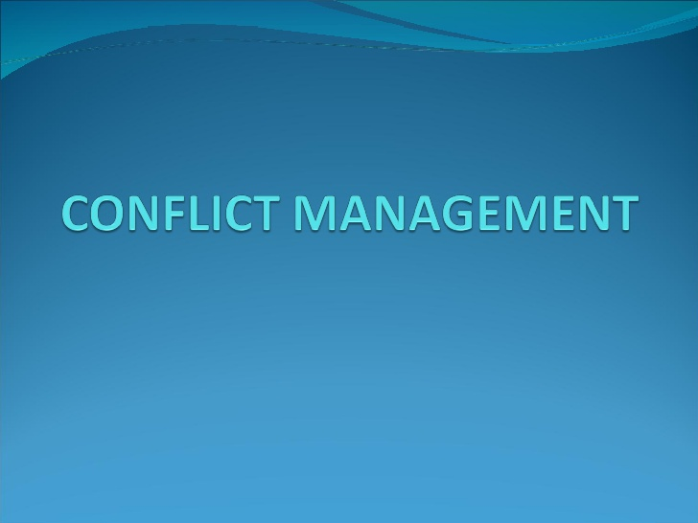
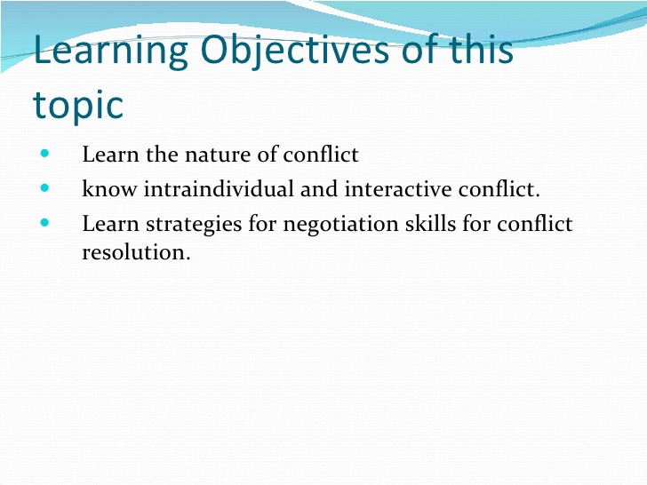

Slide 3
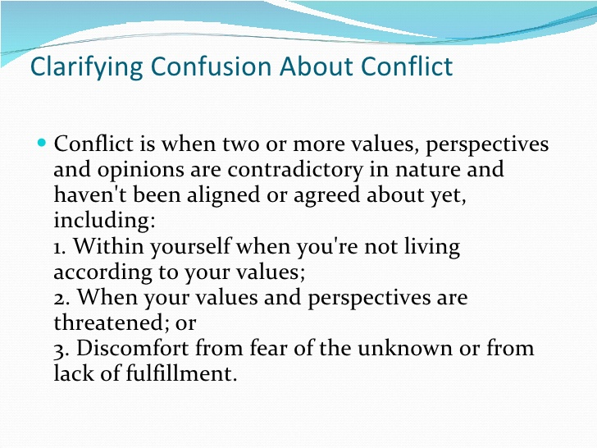

Slide 4
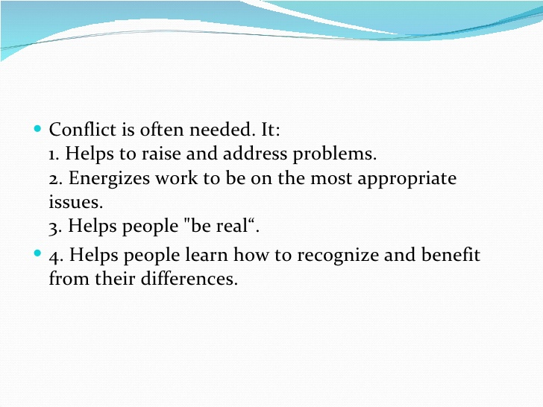

Slide 5
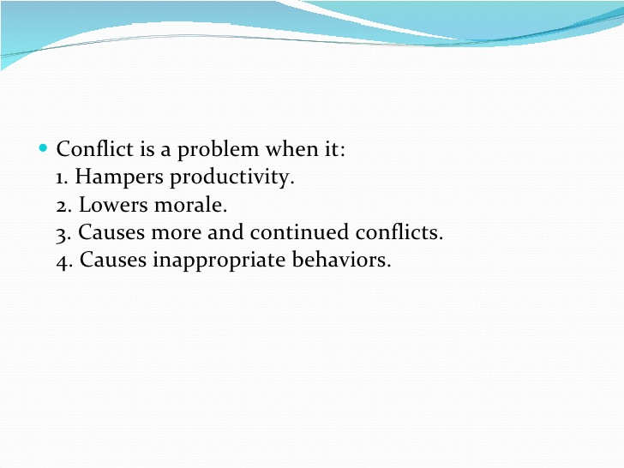
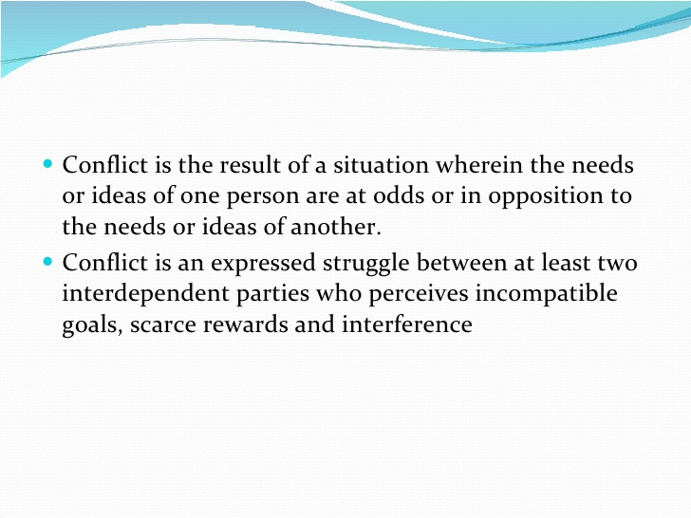

Slide 6
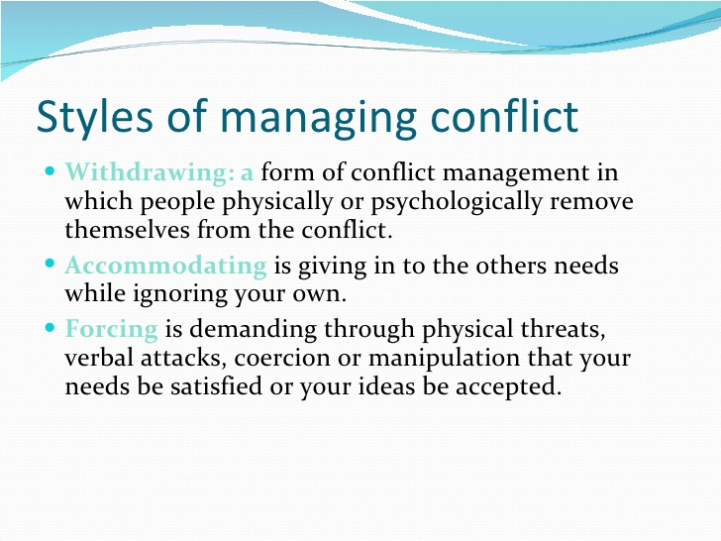

Slide 7
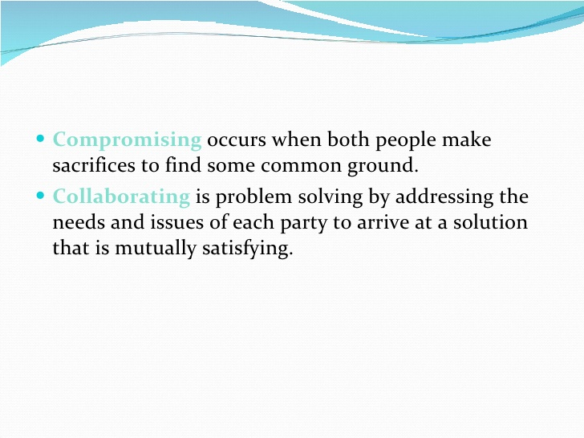

Slide 8
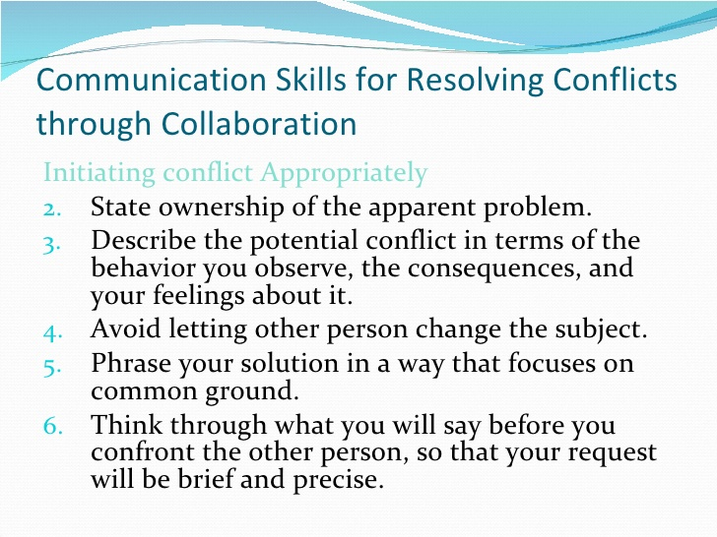

Slide 9
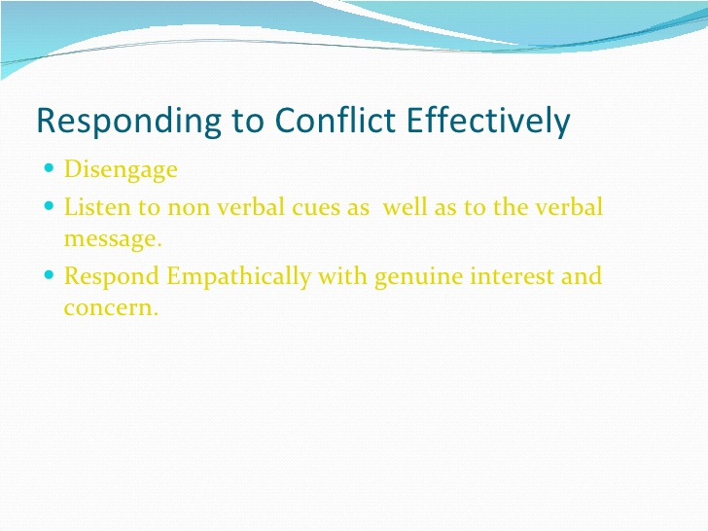

Slide 10
Paraphrase your understanding of the problem and ask questions to clarify issues.
Seek common ground by finding some aspects of the complaint to agree with
Ask the person to suggest alternatives

Slide 11
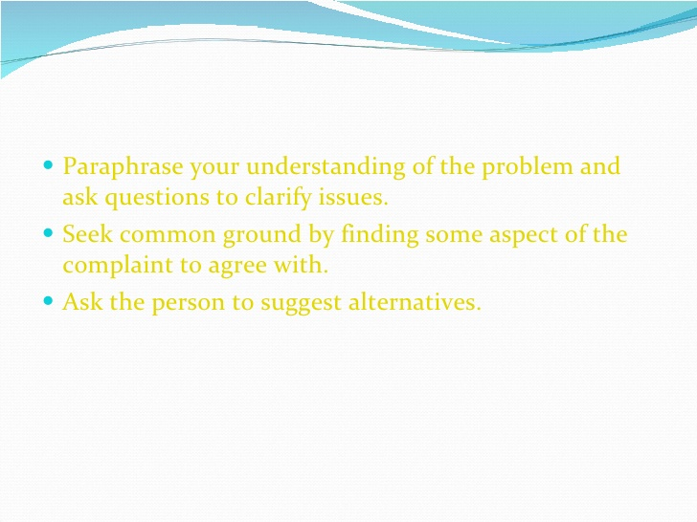
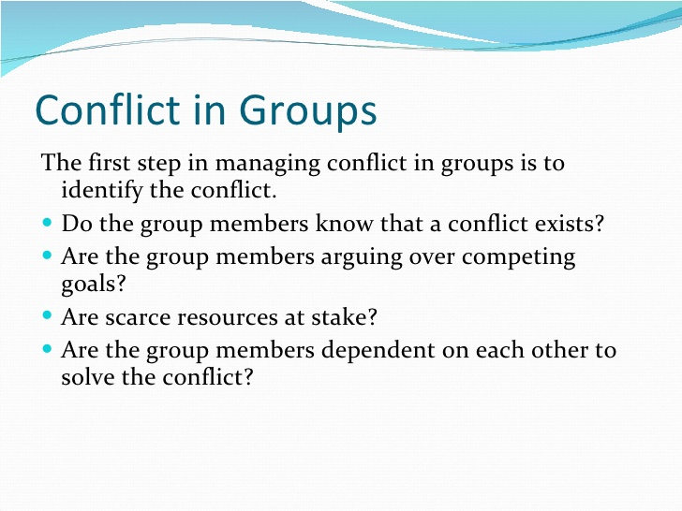

Slide 12
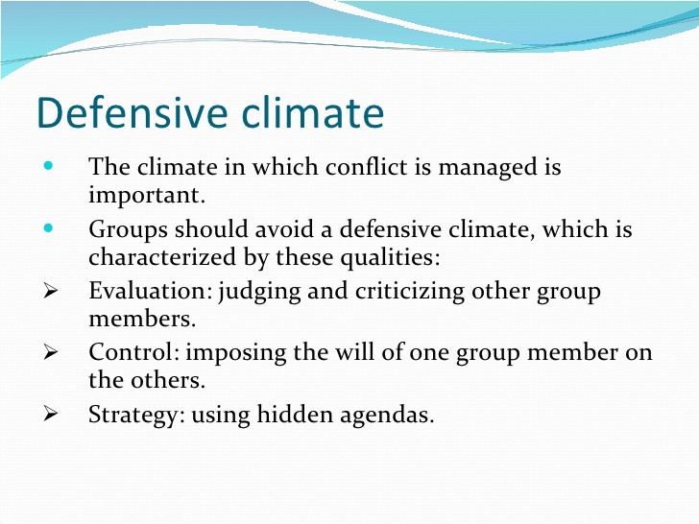

Slide 13
Neutrality: demonstrating indifference and lack of commitment
Superiority: expressing dominance
Certainty: being rigid in one’s willingness to listen to others.

Slide 14
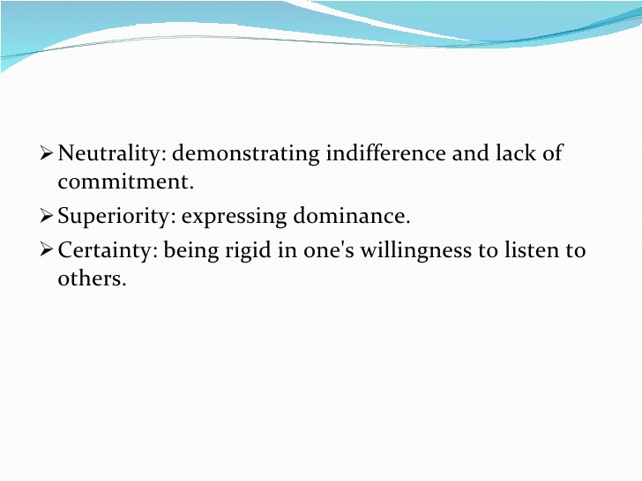
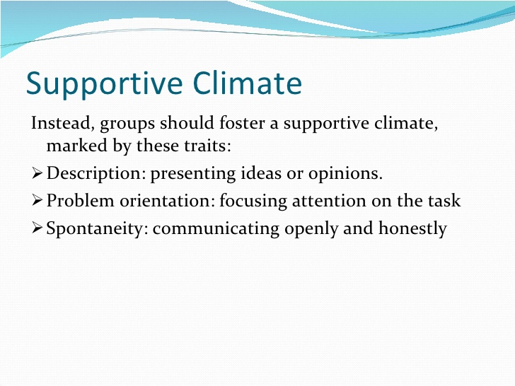

Slide 15
Empathy: Understanding another person’s thoughts
Equality: asking for opinions
Provisionalism: Expressing a willingness to listen to the ideas of others

Slide 16
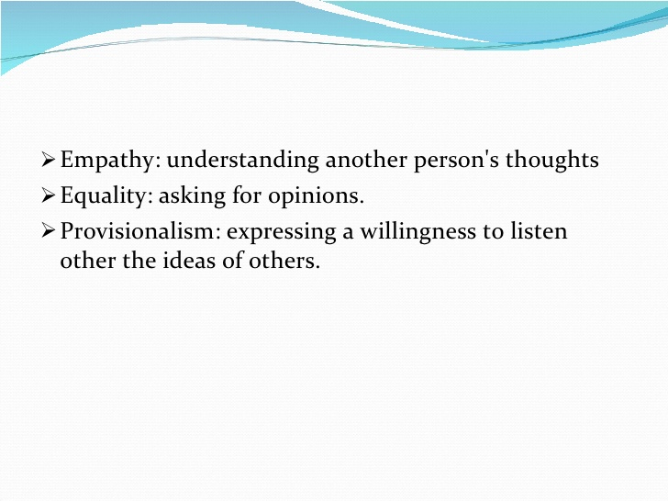
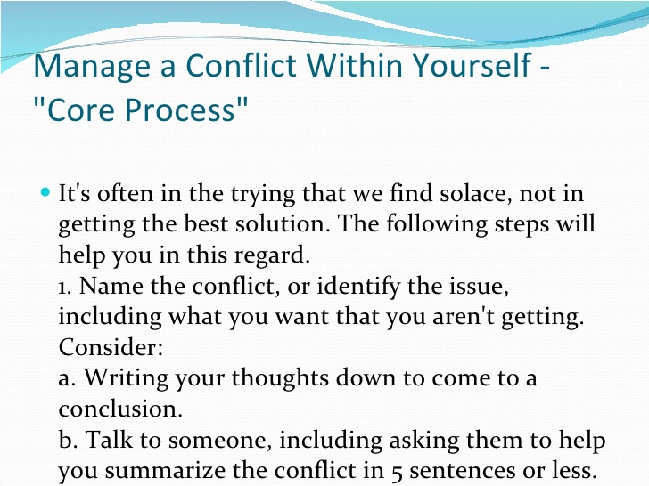

Slide 17
Get a perspective by disscussing the issue with your friend or by putting it down in writing.Consider:
How important is this issue?
Does the issue seem worse because you are tired, angry at something else,etc?
What’s your role in this issue?

Slide 18
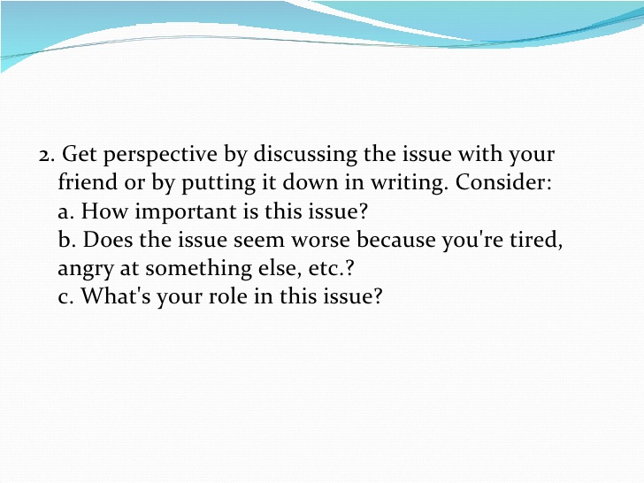
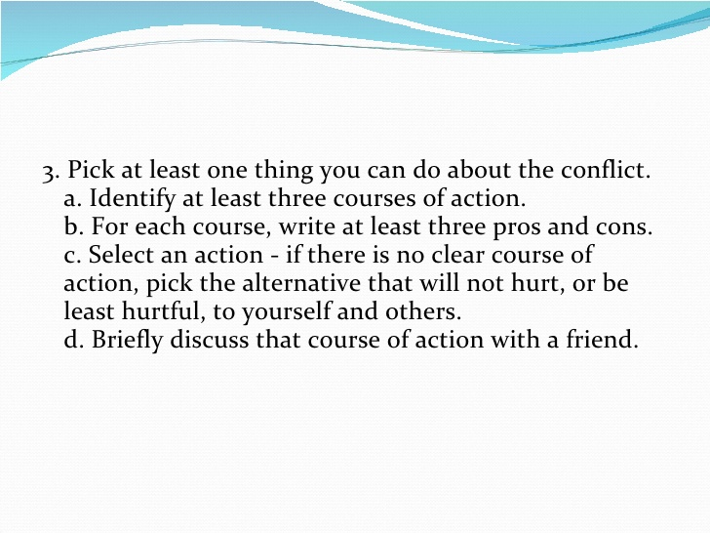

Slide 19
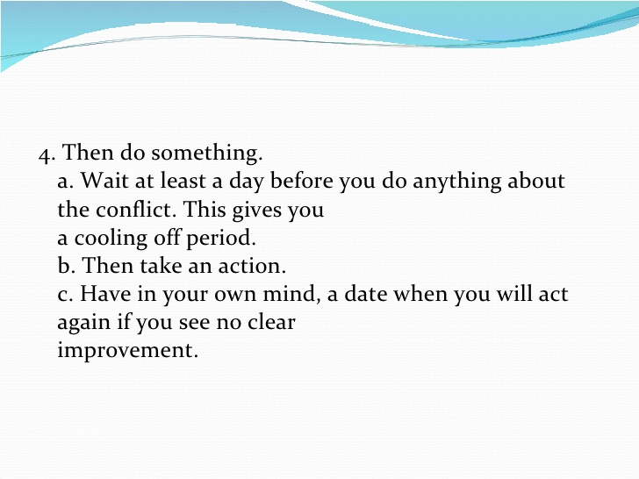

Slide 20
Types of Conflicts
4. Constructive and Destructive
5. Intrapersonal and Interpersonal

Slide 21
Interpersonal Conflict
In interpersonal conflict, you are in conflict with other individuals. This is considered a major level of conflict and can occur between co-workers, siblings, spouses, roommates and neighbors, reports Lewicki, Barry, and Saunders, writing in "Essentials of Negotiation." This is the form of conflict most people have in mind when they think about being in conflict.

Slide 22
Intrapersonal Conflict
According to Lewicki, Barry, and Saunders, intrapersonal conflict is also called intrapsychic conflict. It occurs within you. This conflict can develop out of your own thoughts, ideas, emotions, values and predispositions, reports Lewicki, Barry, and Saunders. Intrapersonal conflict occurs when you internally argue with yourself about something, such as when you want a new pair of shoes but you know you should not spend the money on them.

Slide 23
Significance
These types of conflicts are important because we encounter them on a daily basis and have to negotiate through them. You may think of conflict as negative, but both interpersonal and intrapersonal conflict can have benefits. Healthy conflict provides you with the skills to develop better relationships, gain an understanding of yourself, increase your resolution skills and avoid negative and damaging reactions. Intrapersonal conflict can be disruptive and stressful if you do not understand your own needs and desires, reports Help Guide. Therefore, it is important to understand your deep emotions and interests and stay in touch with yourself, suggests Help Guide. This deeper understanding of yourself will give you a better basis for negotiating through interpersonal conflicts, allowing you to develop better, more trusting relationships, reports Help Guide.

Slide 24
Destructive Conflict
Conflict is typically seen as “bad." This is in reference to destructive conflict. Battles, petty arguments, drug and turf wars, and rants and raves fall into this category.
Constructive Conflict
Two people compete for government money—one advocates cancer research, the other for charity. As they go back and forth, pointing out the flaws in each other’s persuasive attempts, a truly optimal solution is found—hence the “constructive” modifier.

Slide 25
Causes
A number of factors can contribute to destructive conflict in personal and professional relationships. A history of unresolved conflict can significantly increase the potential for destructive conflict, and past experiences with conflict can also influence how people respond to disagreements and arguments. Constructive conflict often grows out of healthy and trusting interpersonal relationships among those involved. Isa N. Engleberg and Dianna R. Wynn, in “Working in Groups,” explain that constructive conflict occurs in relationships where people “can disagree and still respect one another.”

Slide 26
The End

